Slide 1
Schedule-free autonomous boats in Bergen
Dispatch heuristics and reinforcement learning for real-time on-demand fleet operation
NHH . Supervisors: J. C. Goez, S. W. Wallace

Slide 2
The problem
Bergen is by the water.
Autonomous boats could link points that are close by water but far by road, with no driver and no timetable.
We study the on-demant operation of such a service over four points: Kleppesto, Laksevag, Bryggen, Sandviken.
Passengers specify where they want to arrive.
Research question: if on-demand water transport were deployed, which operating method gives the best service. We compare a dispatch heuristic against a learned (RL) policy.
2

Slide 3
Related work
Gu and Wallace (2021). Autonomous water taxis in Bergen. Static location, fleet and routing. DOI 10.1016/j.tre.2021.102456.
Braathen, Goez and Guajardo (2024). Autonomous ferries under labour rules. Static weekly plan. DOI 10.1016/j.martra.2024.100115.
Sanchez-Martinez et al. (2017). Schedule-free high-frequency transit. The operating idea behind this work.
3

Slide 4
Contents
Setup: parameters and assumptions.
Step 1: navigable routing.
Step 2: demand model.
The simulator (the operating environment) and metrics.
Dispatch heuristics H0 to H3, and results.
Fleet-size sensitivity.
The reinforcement-learning model and reward design.
Results and comparison of all methods.
Limitations.
4

Slide 5
System architecture
1. Geography
2. Demand
3. Simulator
4. Policy
4 demand nodes
Water-based routes
OD intensity
Time-varying arrivals
2-min steps
Queues + boats
H0–H3
PPO
Same simulator • same demand • same metrics

Slide 6
Setup: parameters and assumptions
Item | Value / assumption
Network | 4 points, direct point-to-point trips (no multi-stop routes yet)
Time | full day 06:00 to 24:00, decisions every 2 minutes
Boat speed | 30 km/h - 16 knots (design value)
Fleet | swept 4 to 16 boats; capacity 30 per boat
Demand | synthetic, anchored in SSB data, reference = 10% of catchment population (about 8,000 trips/day)
Passengers | They wait until served (no abandonment)
Objective | minimise passengers' time in the system
5

Slide 7
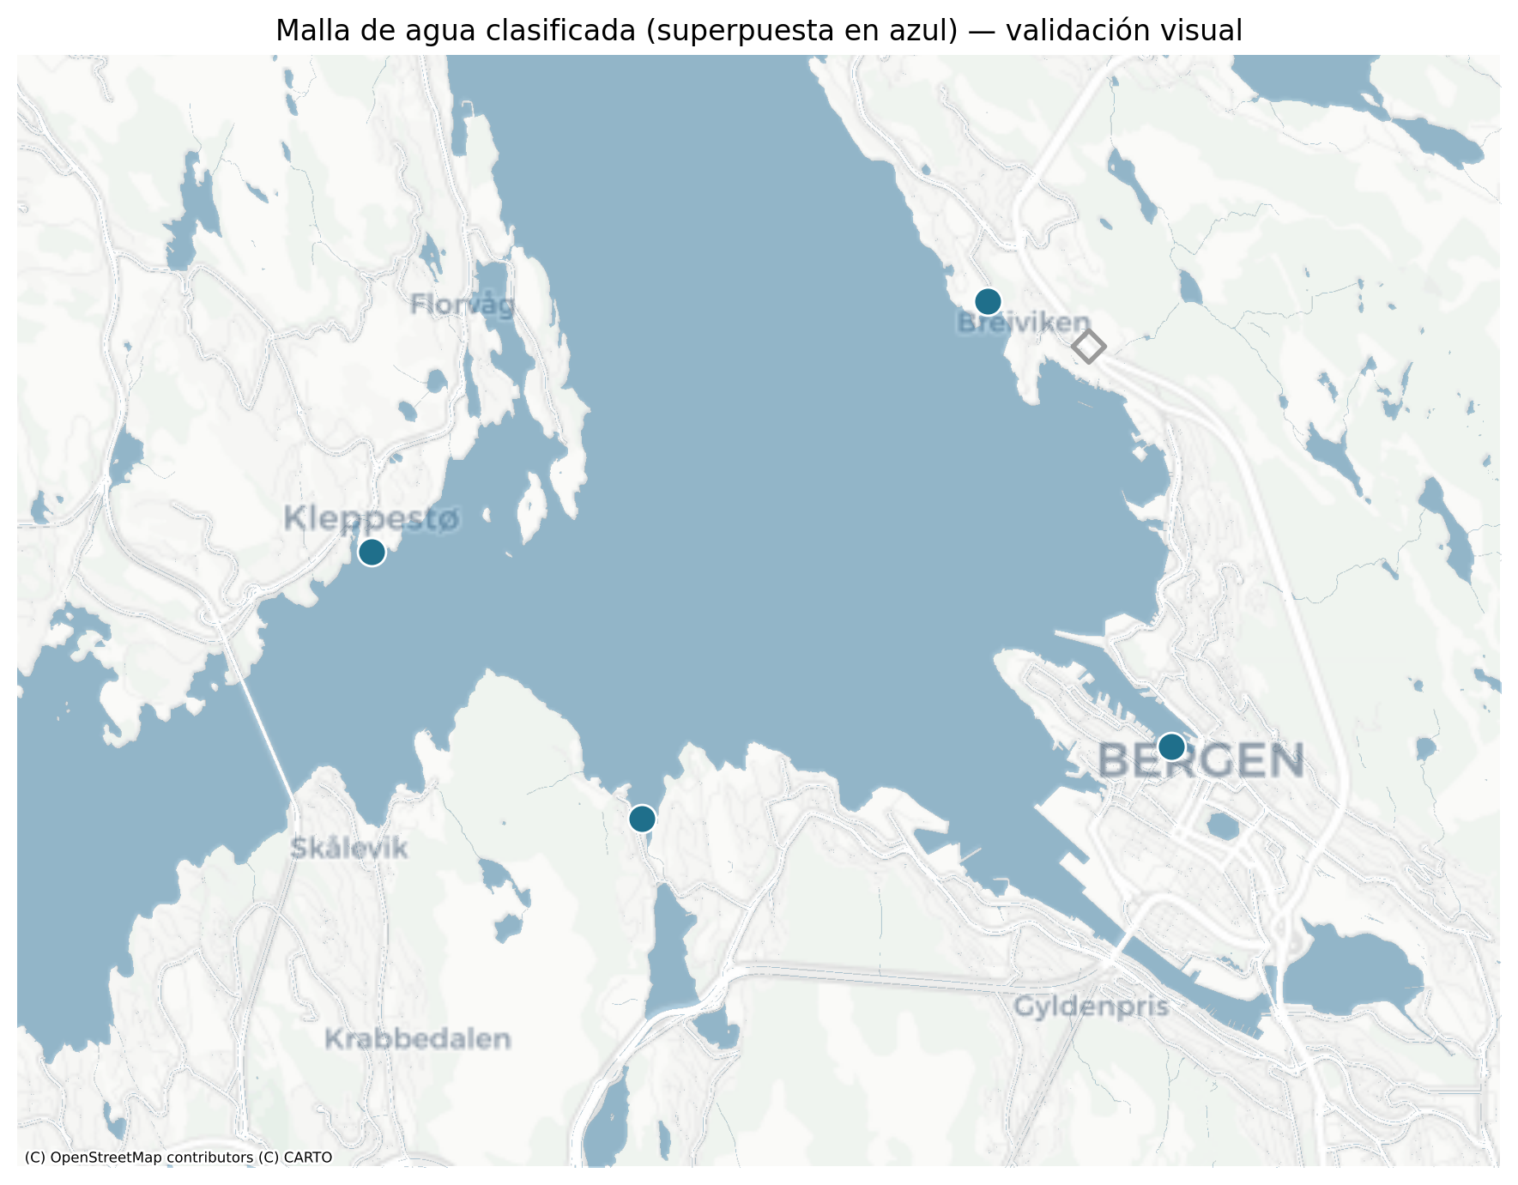
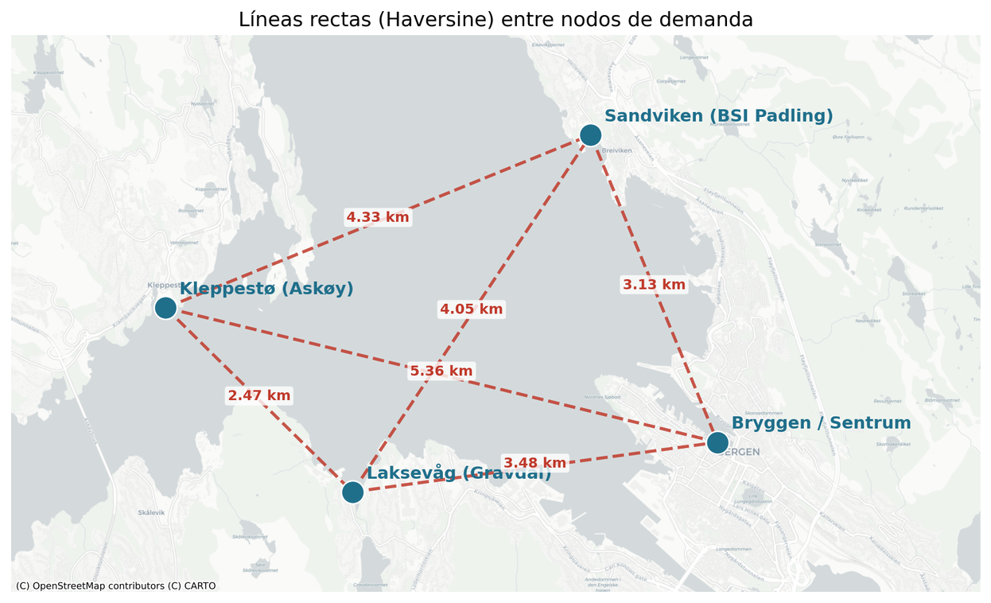
Step 1. Navigable routing: method
Bryggen, Kleppestø, Laksevåg and Sandviken.
Straight lines between points cross land. A boat must go around the coast.
A water/land mask is built from map tiles, classifying each pixel.
Every water pixel is a graph node, linked only to water neighbours.
Water/land mask over Bergen
6

Slide 8
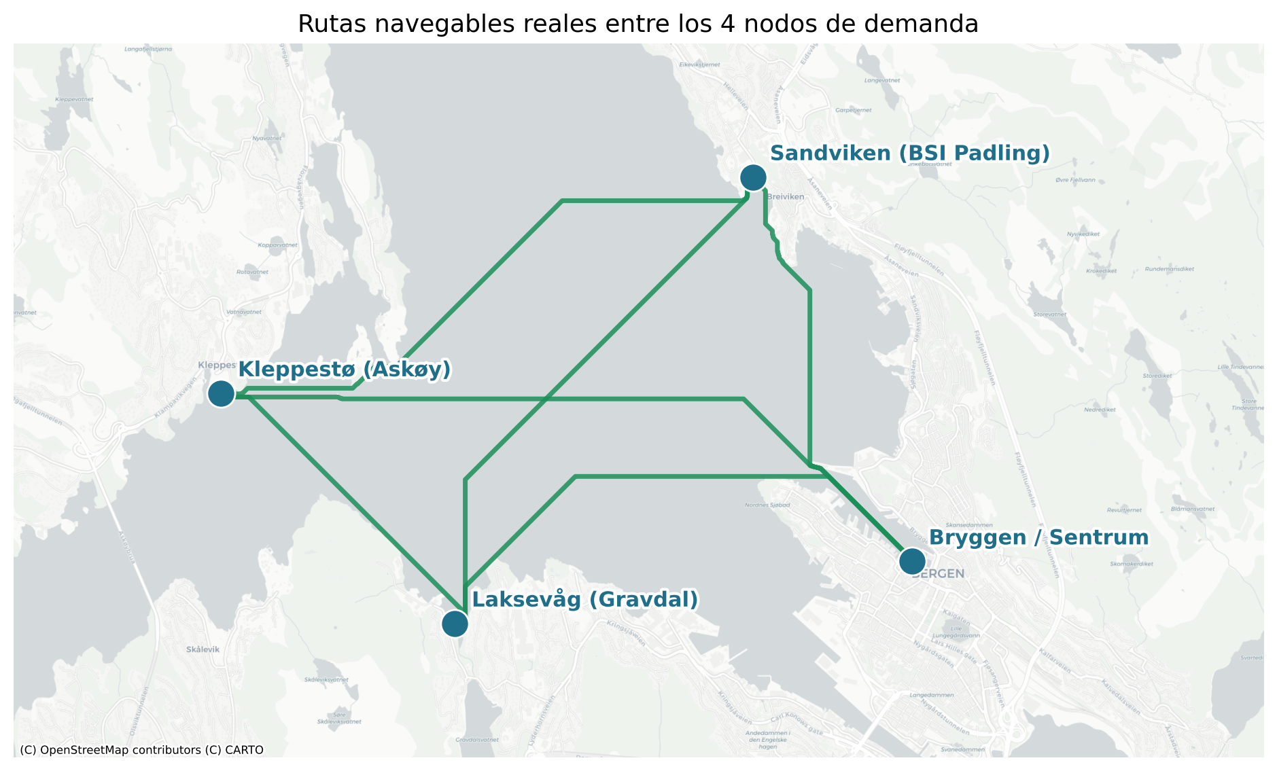
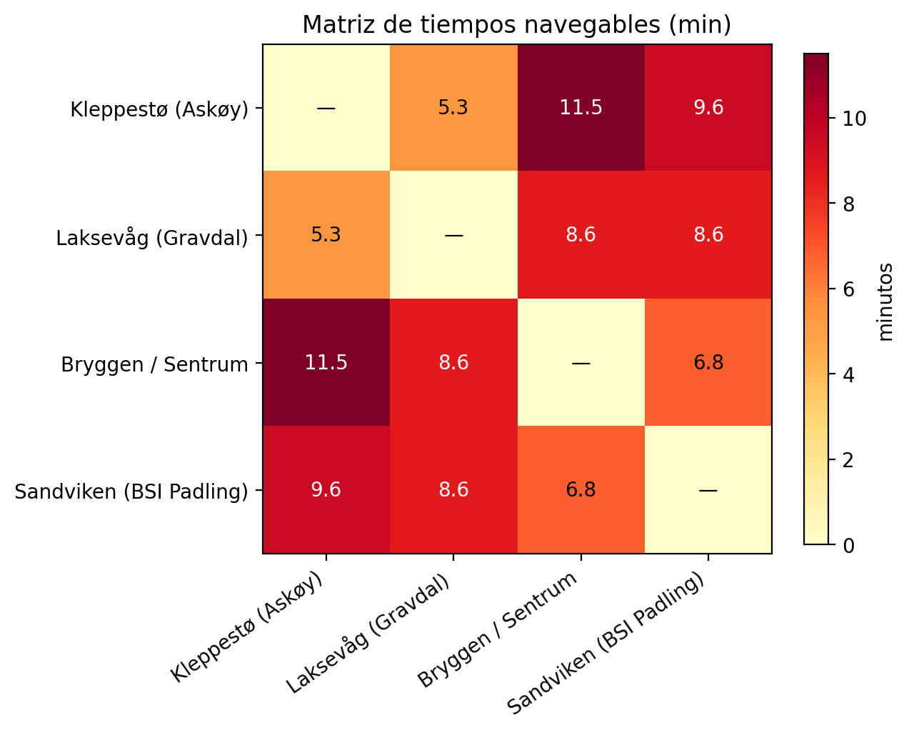
Step 1. Result and calibration
Dijkstra finds the shortest path that never crosses land.
Final configuration uses 30 km/h effective speed.
The output is a travel-time matrix in minutes, used by every later stage.
Navigable routes between the four points
Travel-time matrix (minutes)
7

Slide 9
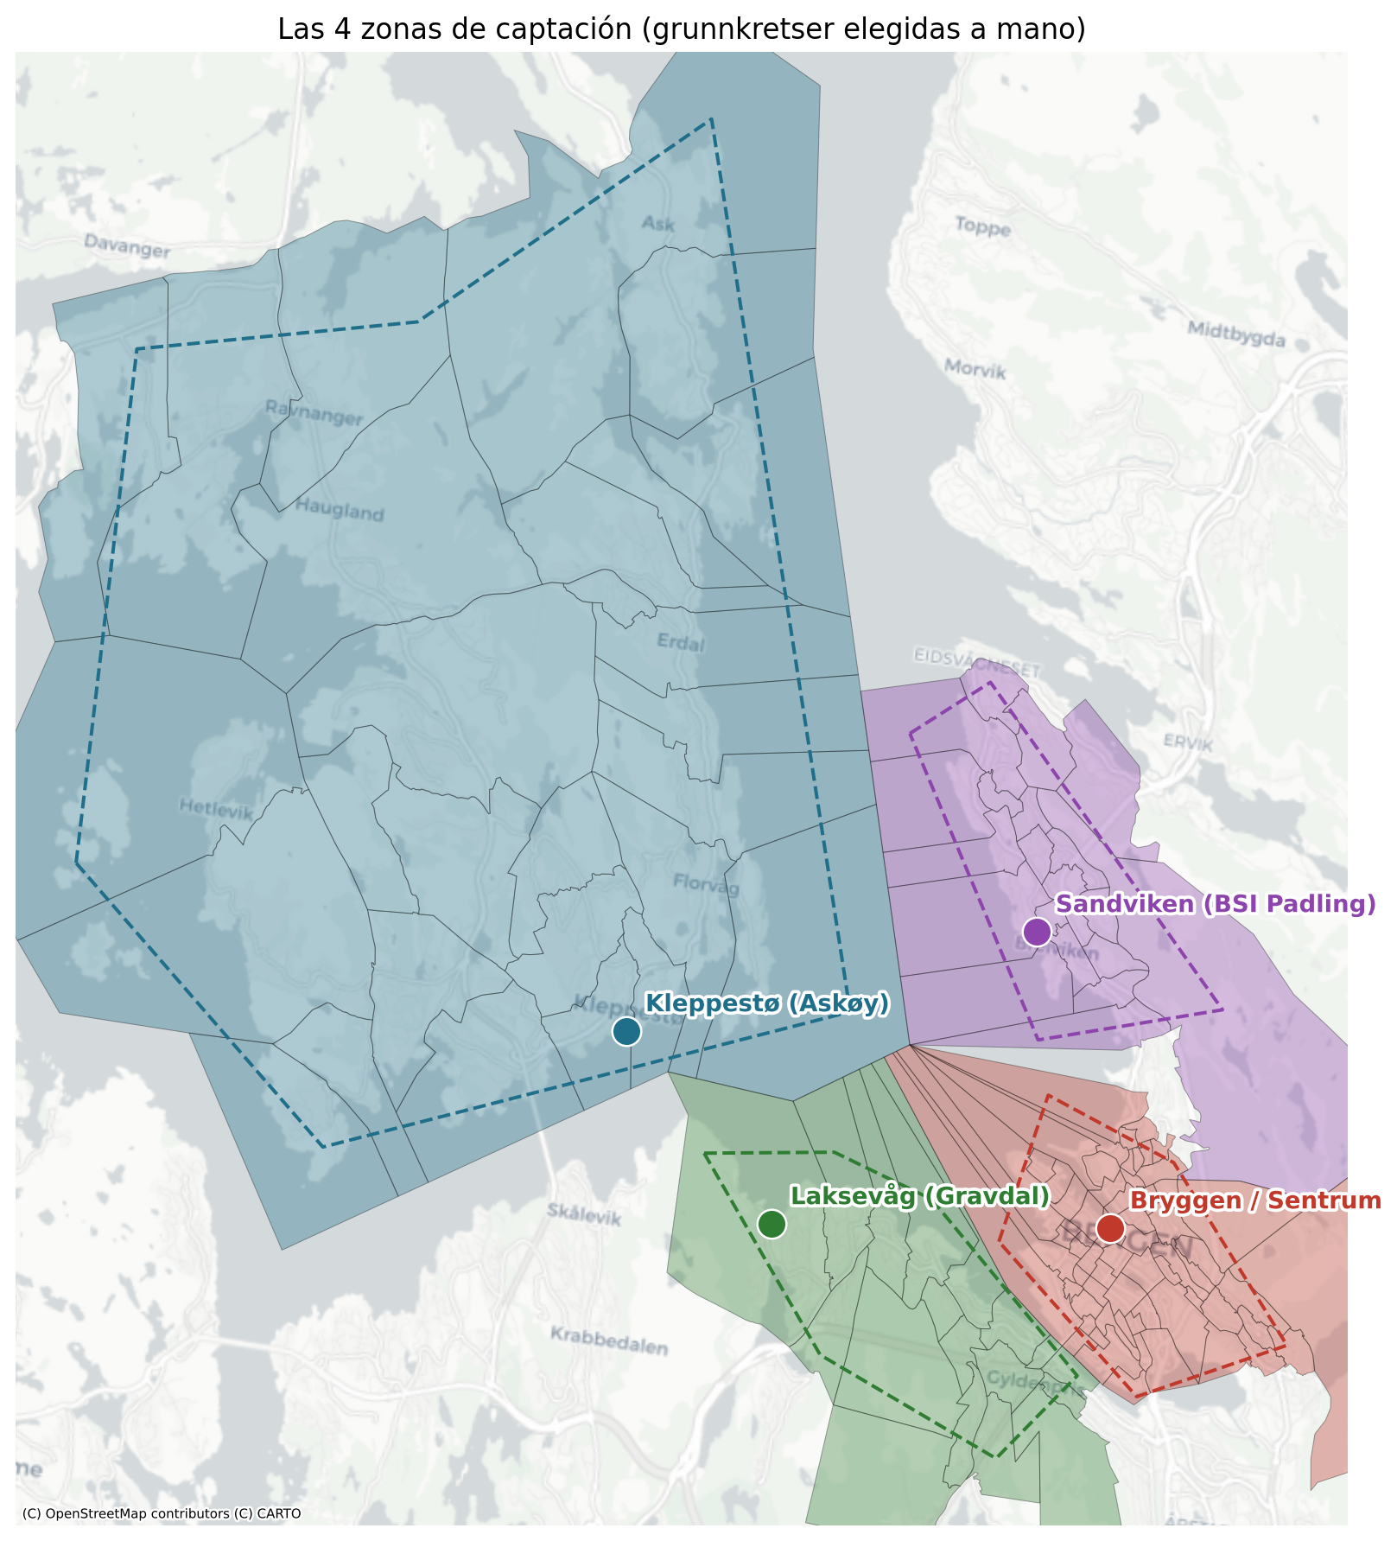
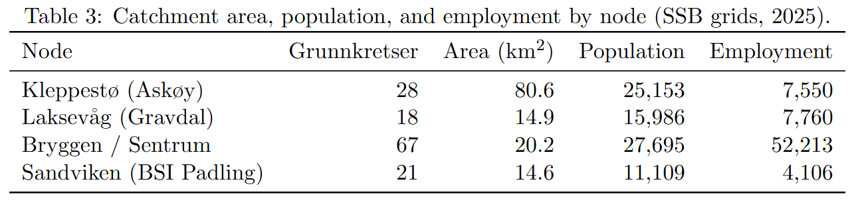
Step 2. Demand model
No real demand exists, so it is generated, but anchored in open data.
Around each point we take the real statistical zones it serves, and read residents and jobs per zone from SSB.
Catchment zones per point (SSB)
8

Slide 10
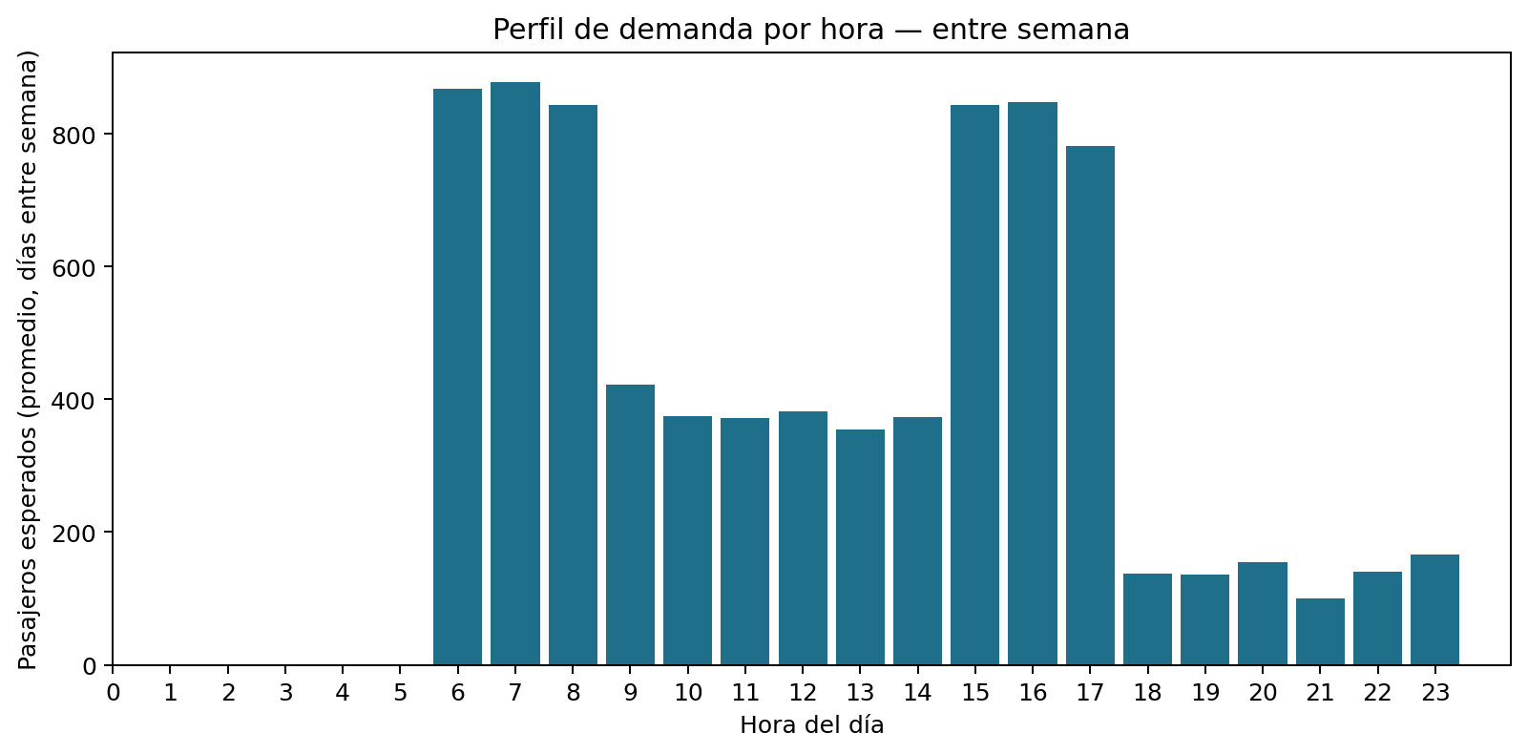
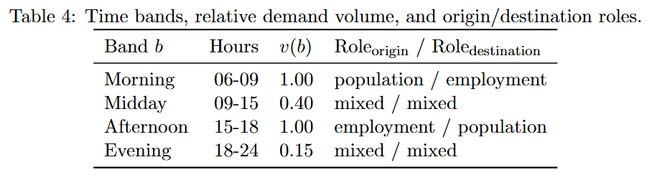
Step 2. Demand model
A gravity-style formulation combines origin mass, destination attractiveness.
Time-of-day roles create different directional patterns. (Morning flow toward the centre, afternoon away from it. The direction split emerges from the data, it is not imposed.)
Arrivals follow a Poisson process whose rate rises and falls with the time band.
10% of catchment population (about 8,000 trips/day)
Demand profile by hour
8

Slide 11
The simulator (the operating environment)
State
boat positions and occupancy, passengers waiting per origin-destination pair, time of day
Action
for each free boat, go to one of the four points, or wait
Transition
boats move on real times, demand arrives, 2-minute steps; direct trips only
Rule
queues are separate per pair; a boat serves one pair per trip, in arrival order, up to capacity
The same simulator is used by every policy (heuristic and RL), so comparisons are fair.
10

Slide 12
The simulator (the operating environment)
State
State = {
"Boats": [
# Boat 0: Still in Bryggen, empty, no passengers
{ "Origin": "B", "Destination": "B", "min to get there": 0, "Occupation": 0 },
# Boat 1: halfway from Kleppestø to Bryggen, with 12 people, 6 min to go
{ "Origin": "K", "Destination": "B", " min to get there": 6, "Occupation": 12 }
],
"Demand waiting": {
# for each origin-destination pair: how many people and how long ago the oldest one waits
"K->B": { “persons": 15, "Wait max minute": 8 },
"K->S": { " persons ": 3, " Wait max minute ": 2 },
"L->B": { " persons ": 0, " Wait max minute ": 0 },
... (All 12 pairs)
}
"Time": { "minute": 465, “day": “lunes" }
}
10

Slide 13
Evaluation metrics
Metric | Meaning
Mean wait | Typical passenger waiting time
P95 / max wait | Tail and worst-case waiting
Mean system time | Waiting + in-boat travel
% served | Completed trips before horizon end
Final backlog | Still queued or onboard at horizon end
Empty movements | Repositioning without passengers
Fleet waiting/free | Share of fleet time not serving
10

Slide 14
Dispatch heuristics: from H0 to H3
H0
Local demand, send each free boat to the longest-waiting queue. Each boat decides alone.
H1
H0 + persistent reservation: once a boat commits to a queue, others do not chase it.
H2
H1 + cost function, but only within local vs remote levels.
H3
H1 + global min-cost assignment: all free boats and all queues compared together. (best)
A boat already travelling to a node, with spare capacity, may still pick up new arrivals of that same queue.
11

Slide 15
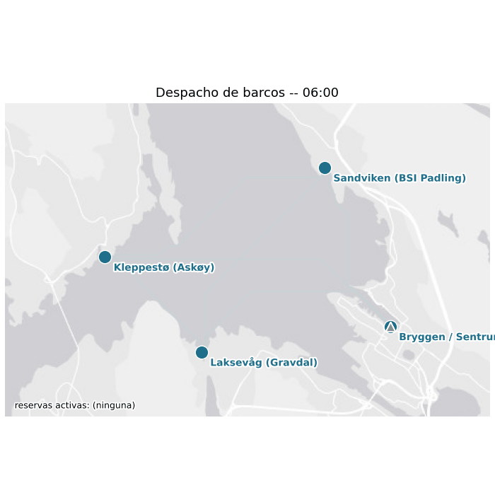
H0 - Reference policy
Decision rule
1. Local demand exists → destination with oldest waiting passenger.
2. No local demand → remote queue with greatest waiting time; tie-break by travel time.
3. No demand → wait.

Slide 16
H1 - Persistent reservations
H1 = H0 + persistent reservation.
A repositioning boat reserves its remote OD queue.
The reservation remains active while the boat is committed.
Other free boats discount reserved capacity.
This fixes a coordination problem across decision epochs.

Slide 17
H2 - Cost within local/remote classes
C(b,q) = T_pickup(b,q) − W_max(q)
T_pickup = time for boat b to reach q queue origin.
W_max = waiting time of oldest passenger.
Local demand → compare only local queues.
No local demand → compare only remote queues.
For local queues T_pickup = 0, so H2 reproduces H0 locally.
The cost mainly changes which remote queue is selected.

Slide 18
16
H3 - Global cost
C(b,q) = T_pickup(b,q) − W_max(q)
Local and remote queues compete simultaneously.
Choose the minimum-cost queue.
A remote queue can beat a local queue only when its waiting-time advantage is large enough.
Threshold: W_remote > T_pickup + W_local.
This explicitly trades urgency against repositioning time.

Slide 19
Heuristic results (12 boats, per component)
Policy | Attended % | Mean wait (min) | wait_p50_min | wait_p95_min | wait_max_min | Mean time in system (min) | Moves | Empty moves
H0 | 99.41 | 6.29 | 5.04 | 15.85 | 30.54 | 16.02 | 1266 | 706
H1 (+reservation) | 99.46 | 7.51 | 6.97 | 17.96 | 37.58 | 17.24 | 874 | 321
H2 (+remote cost) | 99.1 | 6.83 | 5.95 | 16.87 | 27.55 | 16.54 | 860 | 299
H3 (+global cost) | 99.56 | 4.7 | 3.04 | 12.43 | 19.73 | 14.42 | 802 | 182
All policies serve about 99% (people wait until served), so the real differences are wait time and empty moves.
Reservation (H1) roughly halves empty moves. The global cost (H3) further cuts wait and empty moves.
H3 is the strongest heuristic and the benchmark for the rest.
13

Slide 20
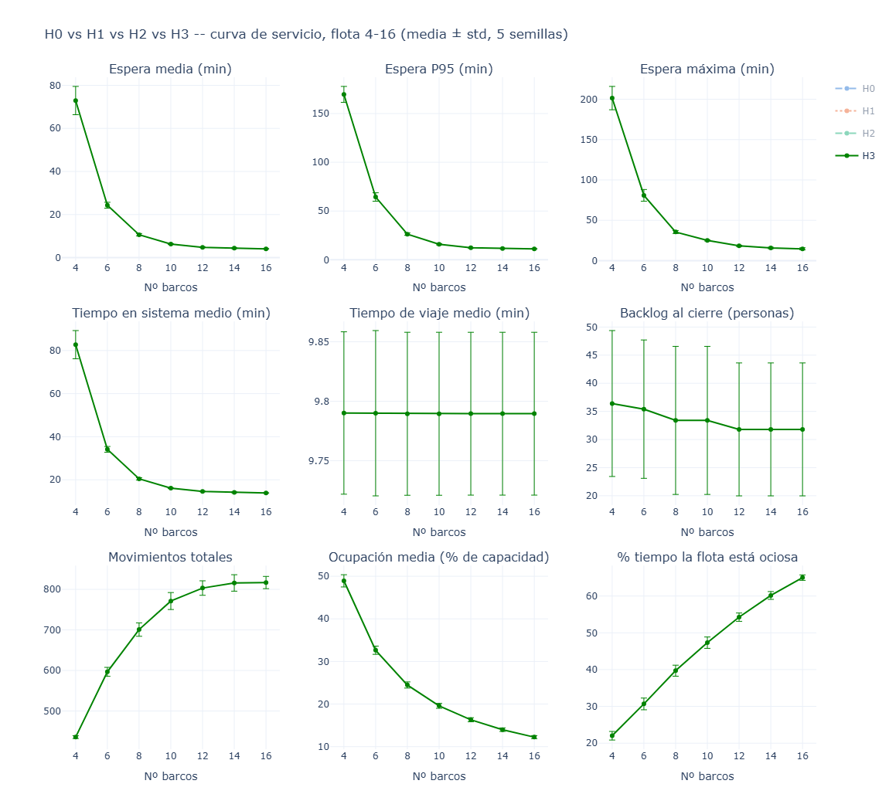
Fleet-size sensitivity (H3)
4 boats saturate: waits explode (about 73 min).
8 boats already give good service.
12 boats reach about 5 min wait.
Clear diminishing returns beyond 8 to 12 boats.
Boats | Wait_media | Wait_p95 | delta_pct
4 | 72.9 | 169.7
6 | 24.3 | 64.4 | -66.6
8 | 10.6 | 26.3 | -56.3
10 | 6.3 | 15.9 | -40.7
12 | 4.8 | 12.3 | -23.7
14 | 4.4 | 11.6 | -8.8
16 | 4.1 | 11.2 | -6.9
14

Slide 21
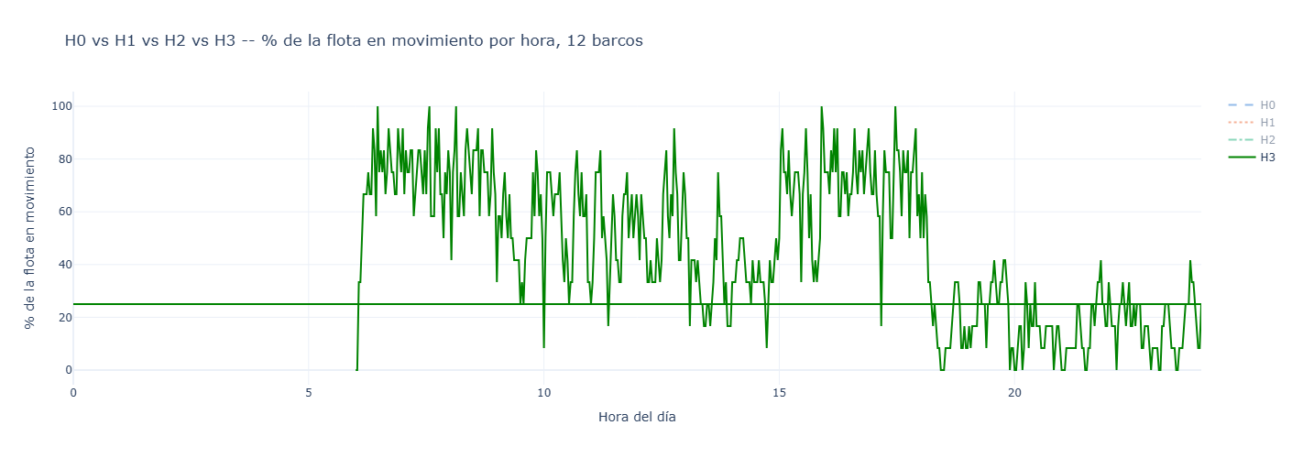
Fleet-size sensitivity (H3)

Slide 22
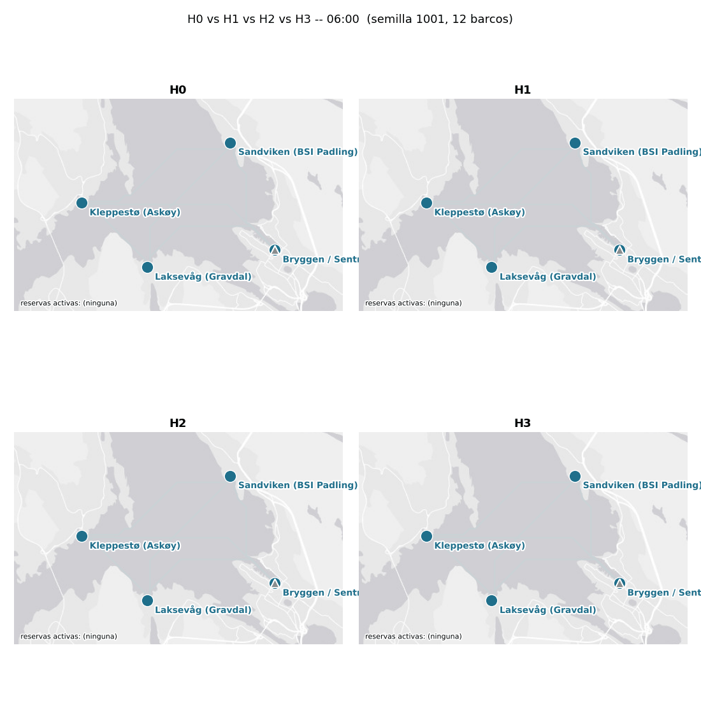
Heuristics in operation
Boats move along real navigable routes.
Queues build and drain at each point.
H3 shows fewer empty repositioning moves than H0.
Live animation: H0, H1, H2, H3 side by side (plays in slideshow)
15

Slide 23
The reinforcement-learning model
An agent decides, each step, where every boat goes, and learns by trial and error to maximise reward.
The action is one choice per boat (a MultiDiscrete space). So we use PPO (Proximal Policy Optimization).
PPO is actor-critic: a policy network chooses actions, a value network estimates how good a state is. Updates are kept small, which makes training stable.
Each training episode draws a fresh demand day, so the agent generalises instead of memorising one day.
Trained on the same scenario as the heuristics (full day, about 8,000 trips, 12 boats) for a fair comparison.
16

Slide 24

Reward design (the key modelling choice)
The reward is the only signal the agent has. A badly designed reward is optimised in the wrong way.
We derived the base reward from the objective: penalising the people present each step equals minimising total time in system.
We tested several variants (see backup). The best was D:
The divisor 12 is only a scaling constant: scaling a reward by a positive number does not change the optimal policy, it only keeps the numbers small for stable training. 12 min is also the longest direct trip, a natural reference.
Every variant is compared on real time metrics, never on its own reward value.
17

Slide 25
Results: all methods compared
 | Percent served | Mean waiting time (min) | 95th percentile wait (min) | Maximum wait (min) | Mean time in system (min) | Total movements | Empty movements | Pct waiting for fleet
H0 | 99.58 | 6.18 | 15.71 | 28.03 | 15.97 | 1268.60 | 704.00 | 26.28
H3 | 99.61 | 4.81 | 12.27 | 18.36 | 14.60 | 803.20 | 200.60 | 54.25
PPO | 99.39 | 12.76 | 37.25 | 105.40 | 22.55 | 1149.80 | 660.60 | 31.72

Slide 26
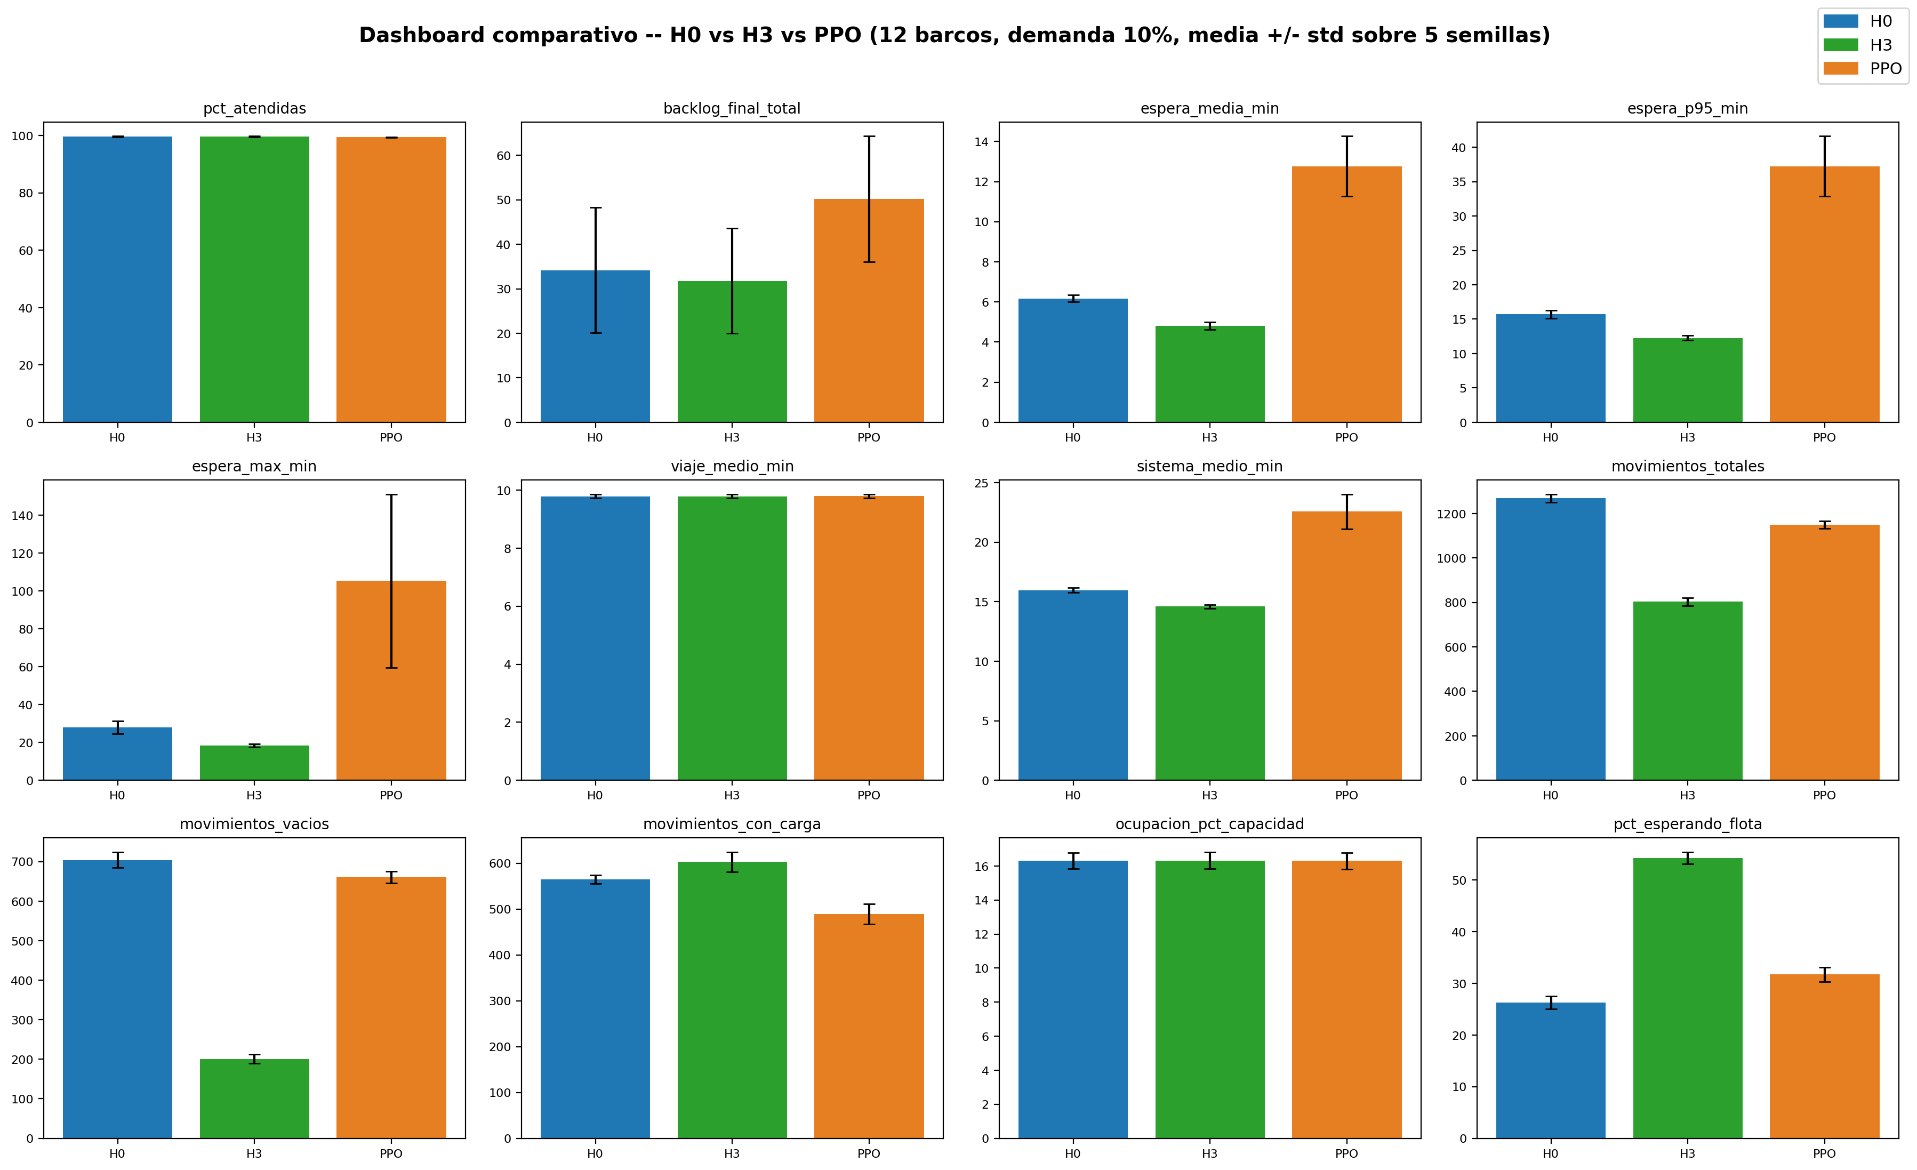
Results: all methods compared
Reward-variant study (full day):

Slide 27
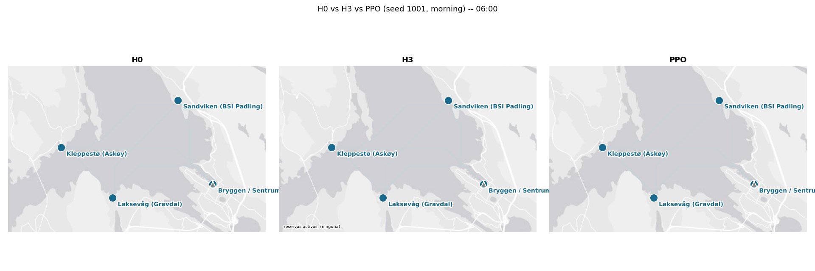
RL agent in operation
Baseline heuristic (seed 1001)
19

Slide 28
Results: all methods compared
Reward-variant study (small):
politica | n_semillas | pct_atendidas_mean | espera_media_min_mean | espera_p95_min_mean | espera_max_min_mean | sistema_medio_min_mean | movimientos_totales_mean | movimientos_vacios_mean | pct_esperando_flota_mean
H0 | 5 | 89.342 | 14.524 | 32.612 | 33.37 | 24.636 | 31.6 | 16 | 32.857
H3 | 5 | 93.403 | 12.905 | 27.887 | 29.4 | 23.058 | 28.6 | 12.8 | 38.901
PPO | 5 | 87.17 | 20.796 | 51.798 | 55.928 | 30.924 | 37.2 | 23.2 | 24.505

Slide 29
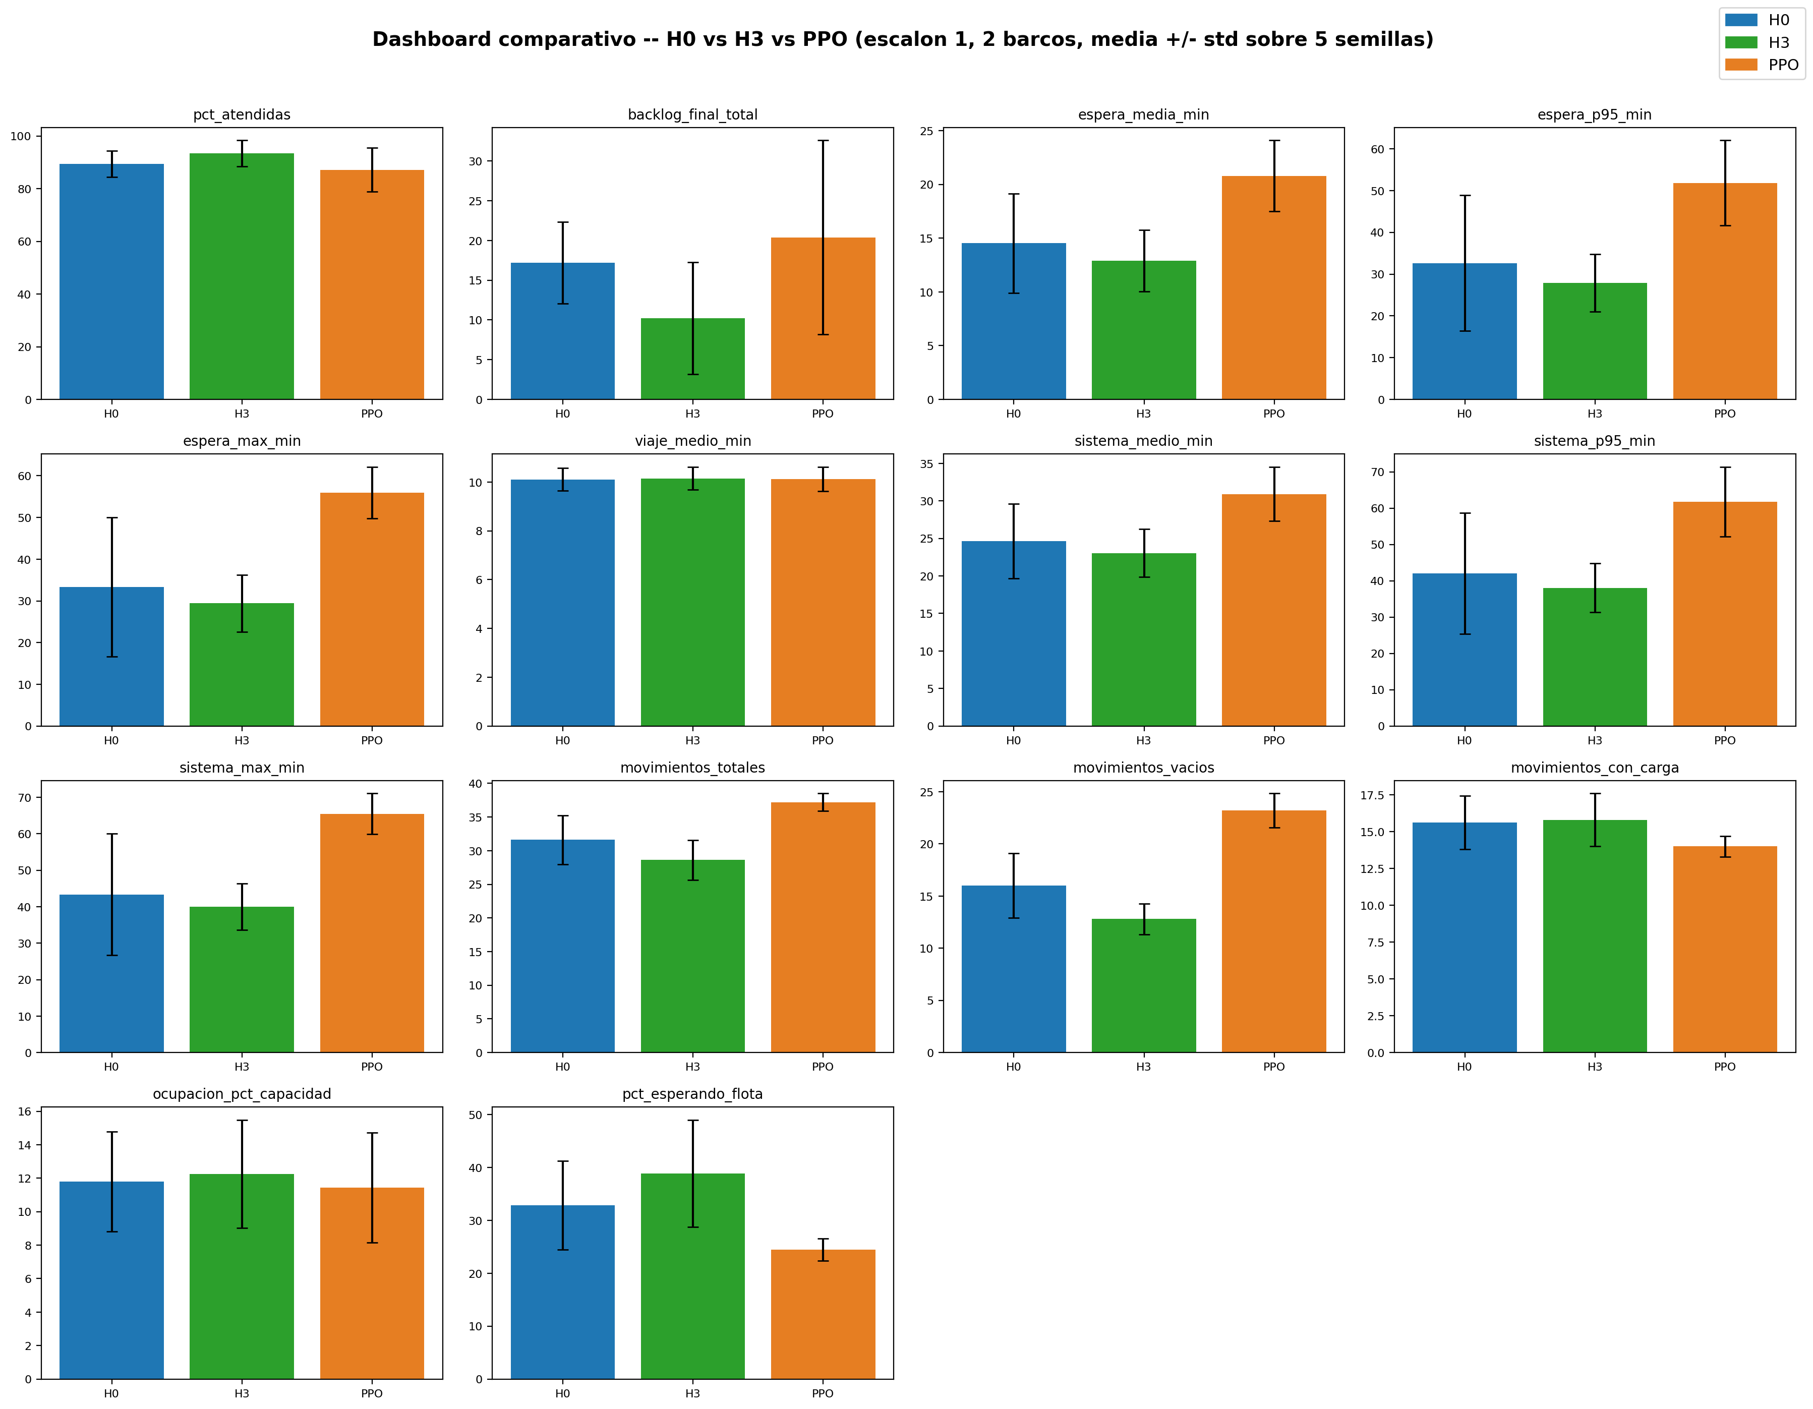
Results: all methods compared
Reward-variant study (small):

Slide 30
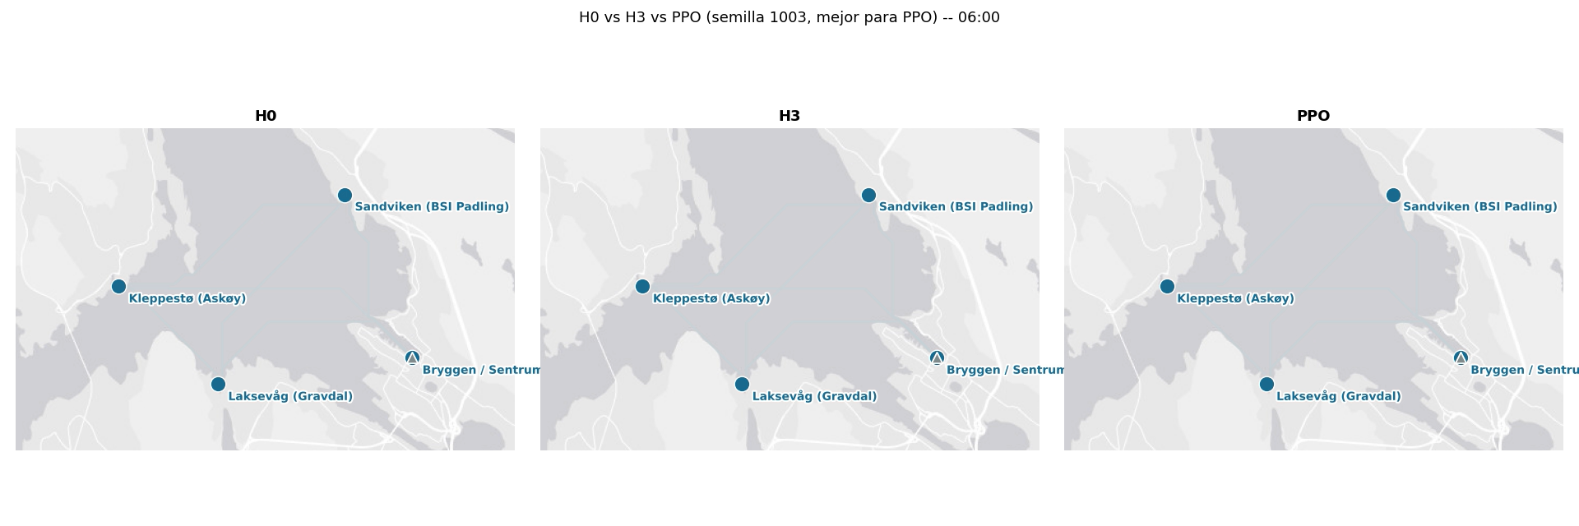
Small: RL agent in operation

Slide 31
34
Limitations and what the results do NOT claim
Demand is synthetic because the service does not yet exist; it is not validated against observed ridership.
Boats make direct point-to-point trips. Multi-stop routes and mixed destinations are a later extension.
Passengers do not abandon the system because of waiting.
Heuristics do not forecast future demand and do not use multi-stop trips.
The comparison is against dispatch heuristics, not a mathematical optimum.
PPO has been evaluated with a limited set of hyperparameters and training configurations.
The current PPO results do not yet demonstrate robust learning beyond the heuristic benchmark.

Slide 32
Next steps
Increase PPO training time and explore additional hyperparameter configurations.
Test alternative reward formulations and training settings.
Investigate heuristic-guided reinforcement learning as an alternative to learning entirely from scratch.

Slide 33
Thank you

Slide 34
Conclusion
Full pipeline built: navigable routing, data-anchored demand, a 2-minute simulator, dispatch heuristics, and a PPO agent.
The heuristic H3 (global min-cost assignment in minutes, with reservations) is strong: reservations cut empty moves, the global cost cuts waiting.
Fleet study shows clear diminishing returns beyond 8 to 12 boats.
The reward is derived from the objective , not hand-tuned; variant D gives the best time in system.
The RL agent operates the same scenario and is compared on real time metrics.
This provides a complete framework for learned, real-time, schedule-free operation.
20

Slide 35
Backup: PPO hyperparameters
BACKUP (hide before presenting)
Hyperparameter | Value
Algorithm | PPO (Stable-Baselines3, PyTorch)
Discount gamma | 0.99
Learning rate | 3e-4
Entropy coefficient | 0.01
Update horizon n_steps | 512
Normalisation | VecNormalize (obs and reward)
Fresh demand per episode | yes
Training steps | 1 to 2 million (until reward plateaus)
Train / eval seeds | separate (held-out evaluation)
21

Slide 36
Backup: full reward-variant study
BACKUP (hide before presenting)
Variant | Idea | Mean time | Max time
A | linear time | 29.2 | 70.3
B | convex, tolerance, no ceiling | 29.0 | 60.8
C | B + potential shaping | 29.2 | 74.1
D | (T/12)² normalised (best) | 25.7 | 51.9
E | linear total time | 41.1 | 123.1
F | T² unnormalised | 33.0 | 81.1
G | incremental time | 33.5 | 109.7
H | other weighted | 37.1 | 103.7
All compared on real time metrics on the same held-out seeds. D wins on time in system.
22

Slide 37
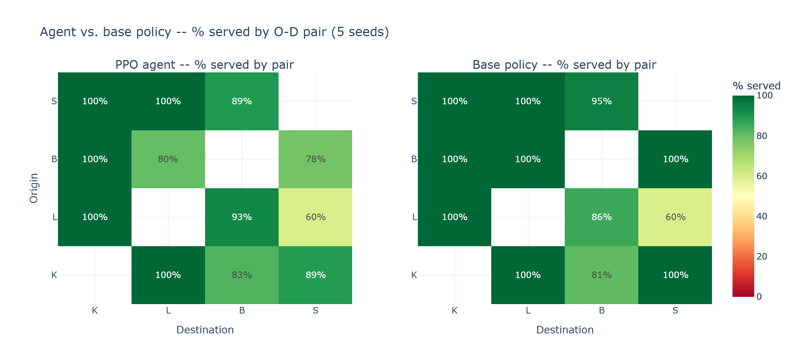
Backup: detail by origin-destination and boat
BACKUP (hide before presenting)
Compliance / service per origin-destination pair
Per-pair and per-boat metrics are available in comparacion/output for any policy.
Useful to spot which connections or boats are the bottleneck.
23

Slide 38
